Slide 1
Hand-Written Character Analysis
Md Mahi Uddin
Basanta Chalise
Richa Kumar
Joshua Peterson

Slide 2

Background - Problem Question
We are provided with a set of hand-drawn characters in a pixelated format
From a data perspective, this can be viewed as a 56 by 56 grid of 1’s and 0’s
Given this format, can we use these grid values as variables to classify hand-drawn letters?

Slide 3

Background - Applications
Archive Digitization
Forensics
Translation (Google Translate)
Source: The Verge

Slide 4
Background - Process
Data Summary and Exploration
Variable Reduction
Model Development
KNN
Random Forest
SVM
Bagging
Model Selection
Prediction
Conclusion

Slide 5
Data Summary
Two Datasets
Labeled data contains 1,000 rows and 3,137 variables
Unlabeled data contains 10,000 rows and 3,136 variables
For both data sets, each row represents a single character, with the first 3,136 variables representing an individual pixel from the matrix on which the character appears.
The pixel columns are binary: a 0 indicates a blank pixel while a 1 indicates a filled in pixel.
For the labeled data, the final variable is a class variable assigning a label to the thousand observations in that data set.

Slide 6
Data Exploration - Labeled Data
We begin with labeled data to get an idea of the structure of the data, what the letters look like, etc.
Looking at a distinct observation from each letter, we can begin to make some initial observations.

Slide 7
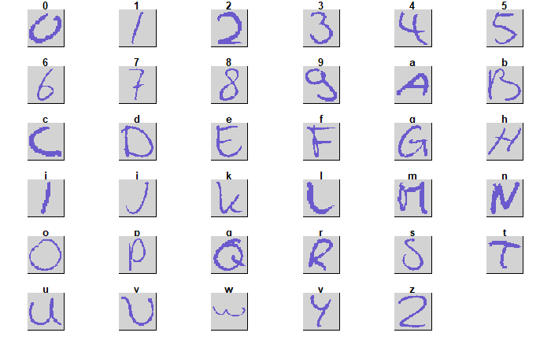

Slide 8
Data Exploration - Labeled Data
We begin with labeled data to get an idea of the structure of the data, what the letters look like, etc.
Looking at a distinct observation from each letter, we can begin to make some initial observations.
Most of each individual image is blank space.
Numerically it is a roughly 85% to 15% split in space usage across the data set.
The distribution of that space, however, is distinct, giving us the shapes of our characters.

Slide 9
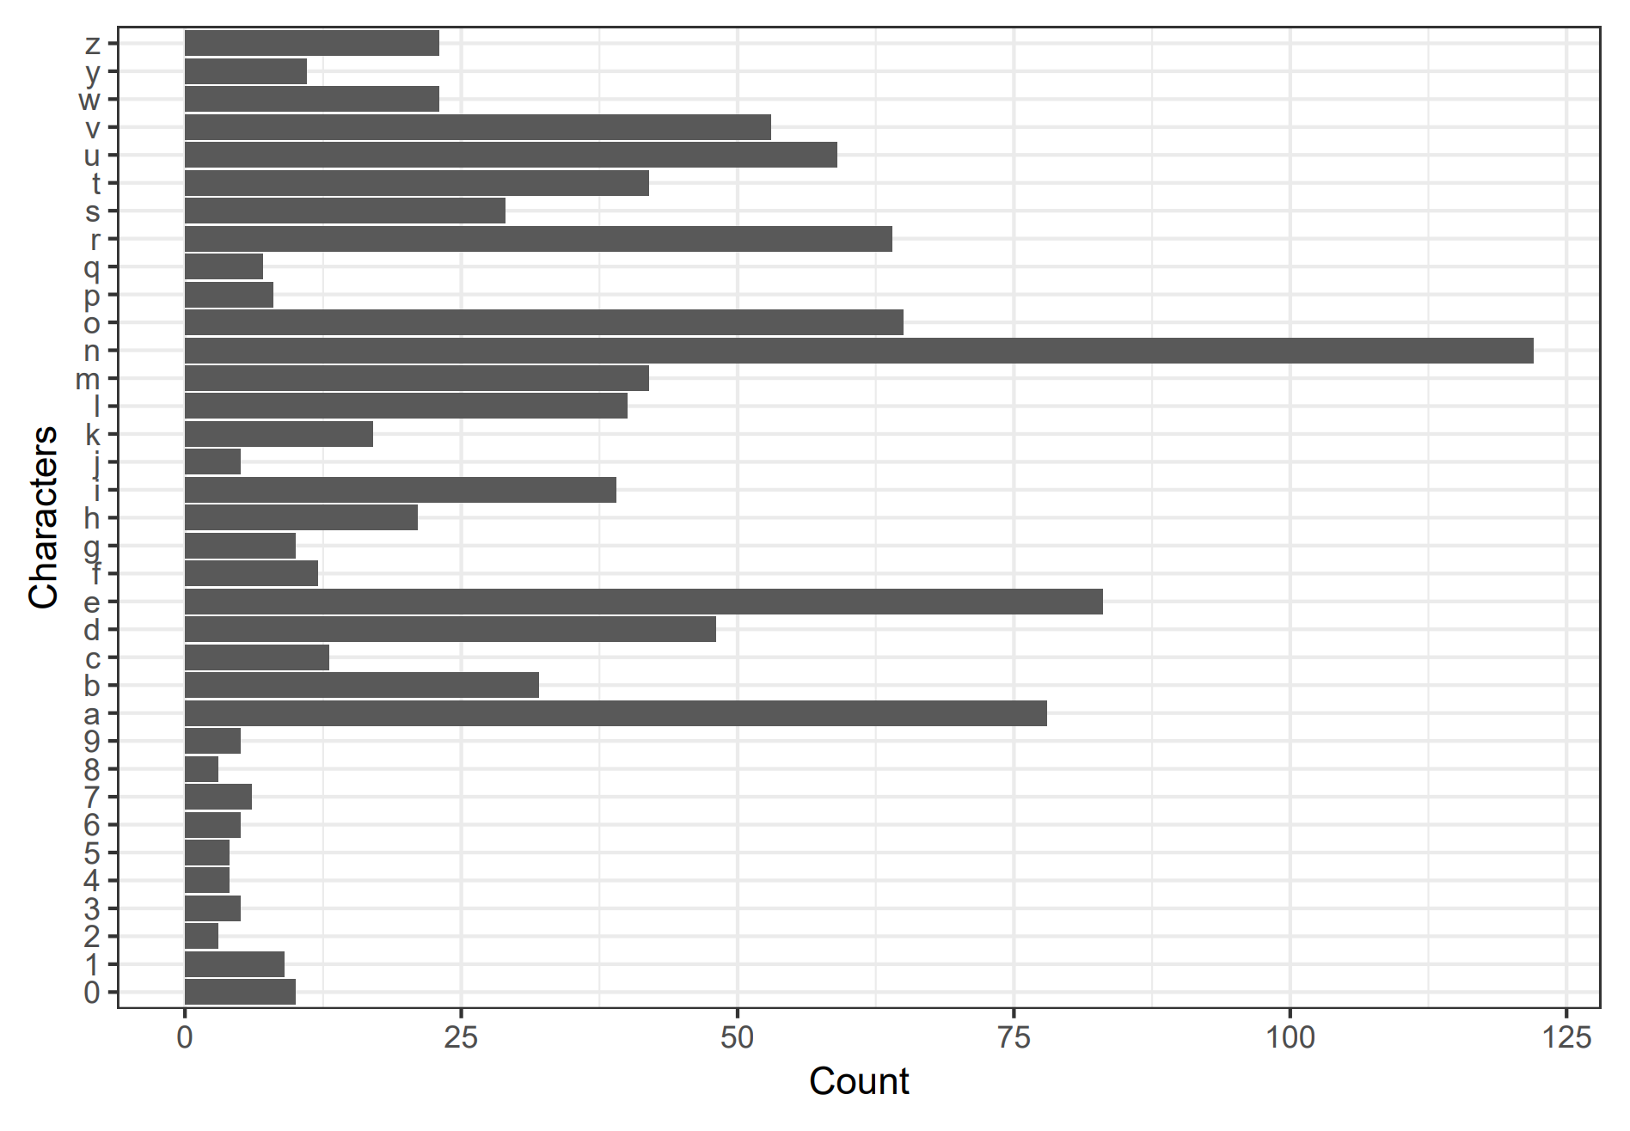

Slide 10
Data Exploration - Labeled Data
Frequency plot shows high variance in distribution of characters
Most notable difference is a much higher representation of letters vs numbers
Some letters also much higher representation than others, including n, e, a, o, and u.
Despite having 1,000 observations, number observations generally have less than 10.
Plotting the mean and standard deviation for each character shows that some are more consistent than others.

Slide 11
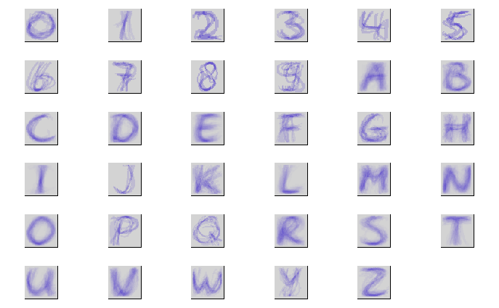
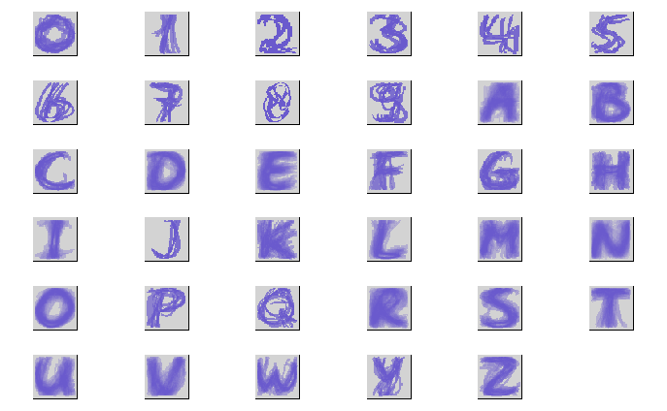
Mean
Standard Deviation

Slide 12
Data Exploration - Unlabeled Data
Unlabeled data contains 10,000 additional observations
Given low n of some letters for labeled data, these additional observations are essential to building a reliable model
Opted to manually label by using a looping algorithm to efficiently cycle through the observations
As several characters like O and 0, 1 and I, u and v, etc have quite similar features and contour, best judgement and a majority vote from group members was used to label more ambiguous cases with examples from the labeled data set used as a baseline.

Slide 13
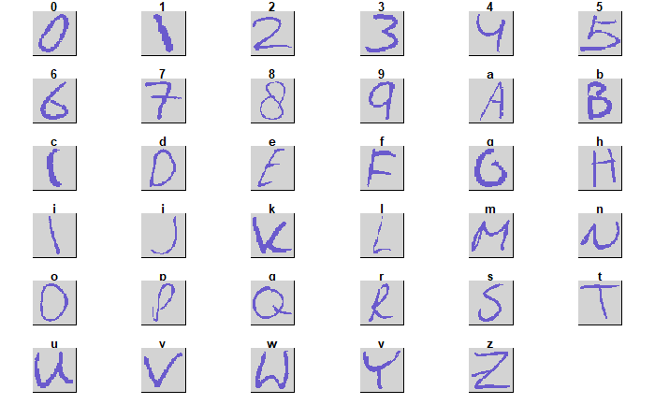

Slide 14
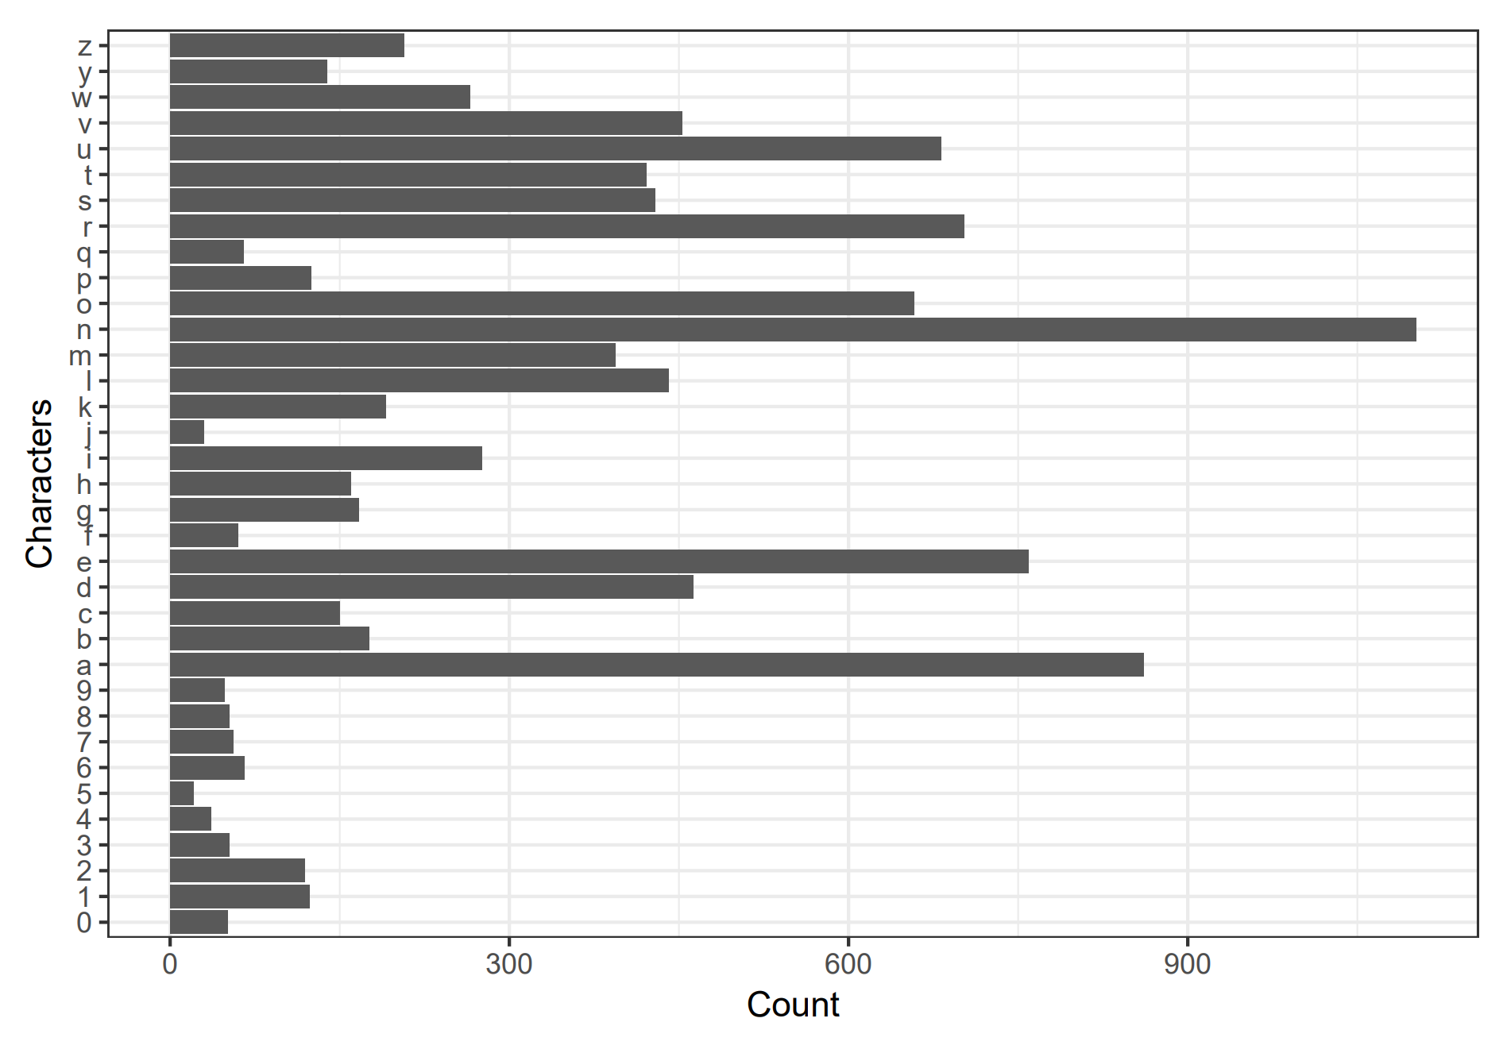

Slide 15
Data Exploration - Unlabeled Data
We can see from the previous slides that the unlabeled data is similar to the labeled both in character structure and frequency.
We still have a lower selection comparatively of numbers versus letters, but they now number closer to values between 30 and 50 instead of 5 and 10.
Similarly, the mean and standard deviation seem comparable to the labeled data.

Slide 16
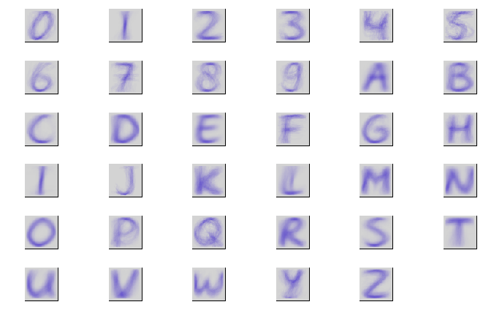
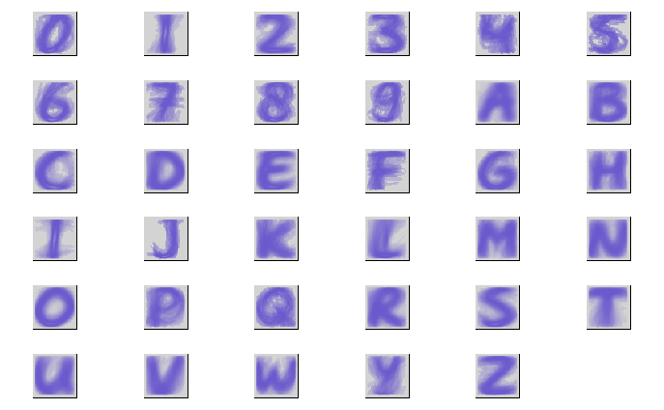
Mean
Standard Deviation

Slide 17
Data Exploration - Character Structure
After variable frequency, the biggest issue in both the labeled and unlabeled data is character structure
First, we have a number of characters that are visually very similar to each other (1 and I, 2 and Z, 5 and S, etc.)
Second, we have multiple writing styles that result in different shapes for the same character
These are issues that will factor into final model selection: we want the model that not only performs best overall, but also most accurately labels on a per-character basis

Slide 18
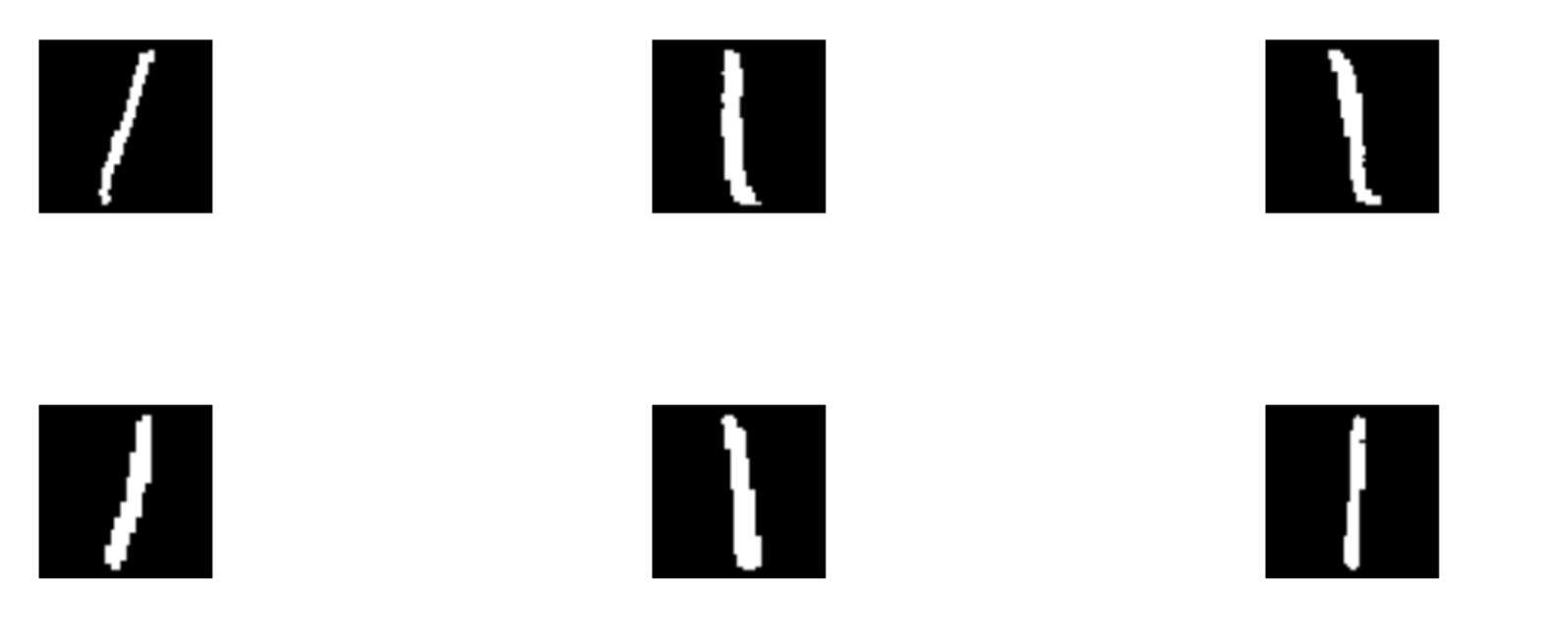
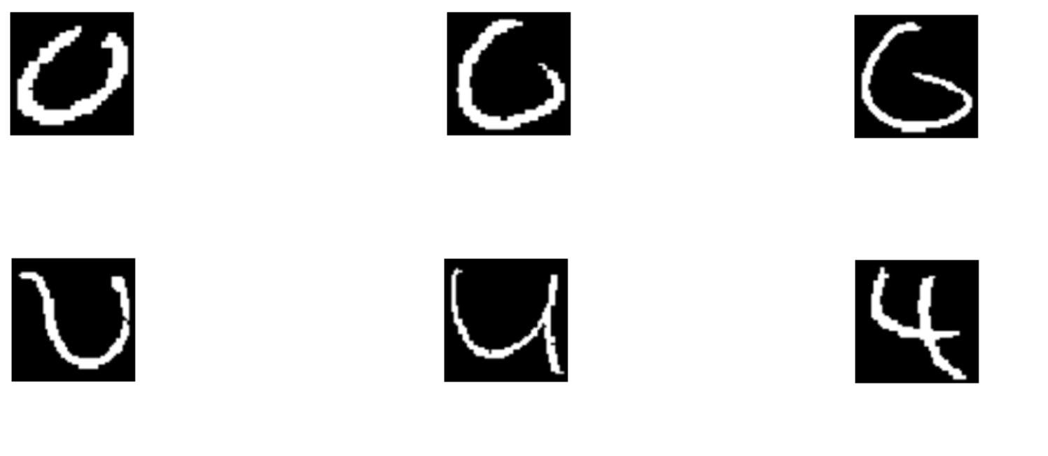
1
1
1
I
I
I
O
0
G
V
U
4

Slide 19
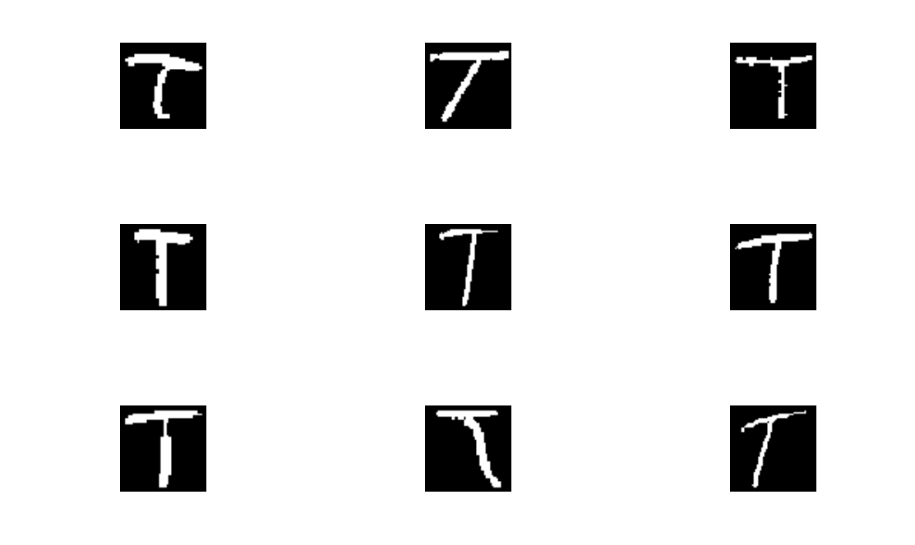

Slide 20
Variable Reduction
3,136 is a computationally expensive number of variables to work with, especially when a significant portion of them represent empty space that is shared between characters
However, not all empty space is irrelevant, as at a certain point it is important for distinguishing between characters
To reduce variable number, we need a method that reduces excess empty space while retaining the defining shape for each character

Slide 21
Variable Reduction
To accomplish this, we use a blurring method that takes an average of a selection of pixels
We take a 4x4 grid of pixels and calculate the average, which we code as a new pixel in a modified data set
These new pixels act as a representation of the old pixels, and are grayscale instead of black and white, with values ranging from 0 to 1 in 1/16 increments
This reduces number of variables from 3,136 to 196 while retaining the shape of character

Slide 22
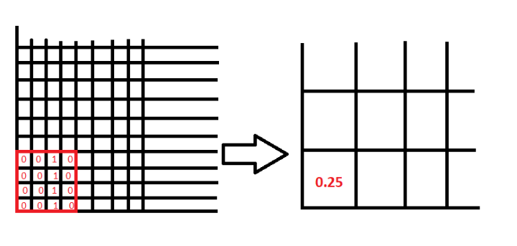
Variable Reduction

Slide 23
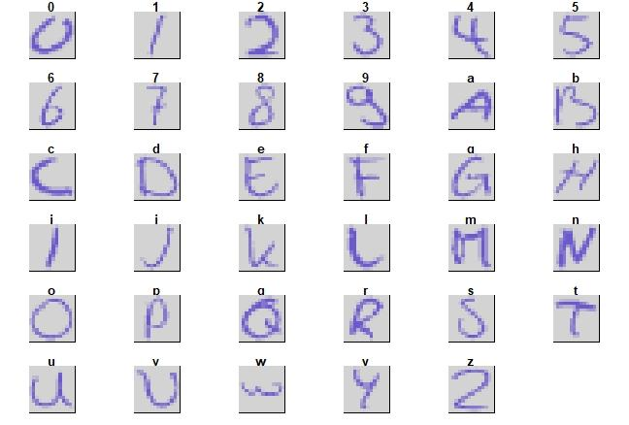
Original
Blurred

Slide 24
Model Development
We have 35 classes, so this is a multi-class classification problem
Certain methods such as logistic regression do not work well with non-binary outcomes
To address this, we chose the following four methods:
K-Nearest Neighbors
Random Forest
Bagging
Support Vector Machine

Slide 25
K-Nearest Neighbors
Classified by a majority vote of its neighbors, with the object being assigned to the class most common among its k nearest neighbors
optimal value of K was chosen from odd values of K from 1 to 22 with 5-fold cross validation
K-value of 1 chosen as optimal with an error rate of 24.2%
Accuracy of 75.75% on the overall validation data

Slide 26
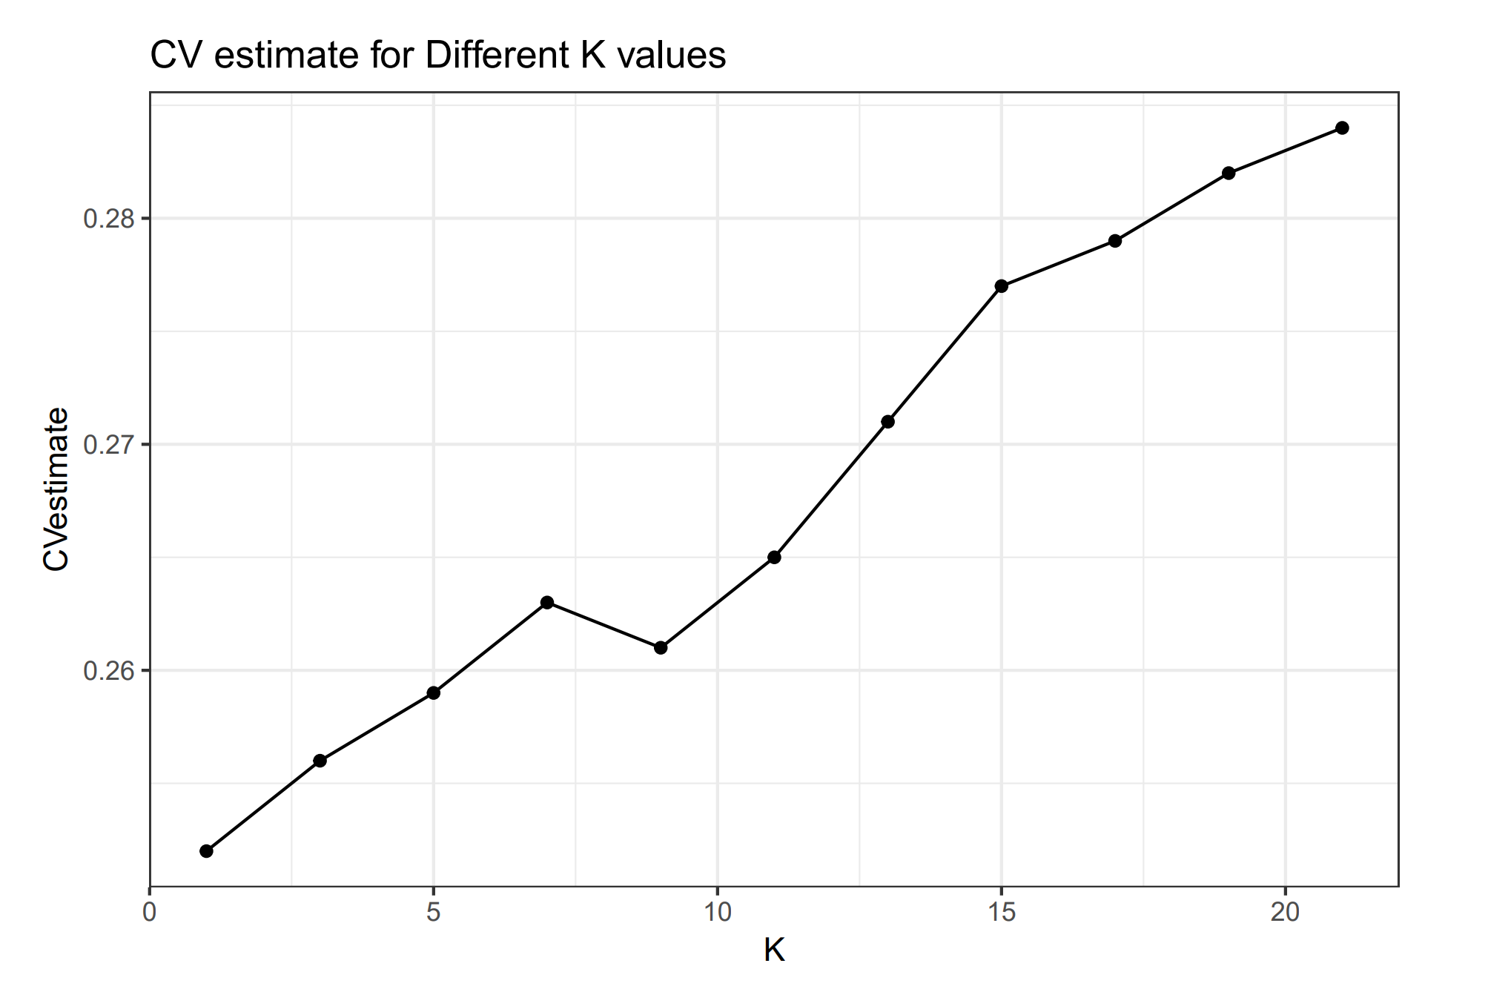

Slide 27
Random Forest
Ensemble learning method that uses a multitude of decision trees during training and outputs the class that is the mode of the classes of the individual trees
500 trees were grown and the optimal value of number of variables (mtry) to be considered for splitting chosen via 5-fold cross validation
resulting error rate of 20.1% when 25 variables were randomly chosen for the split, with 80.35% overall accuracy on validation set

Slide 28
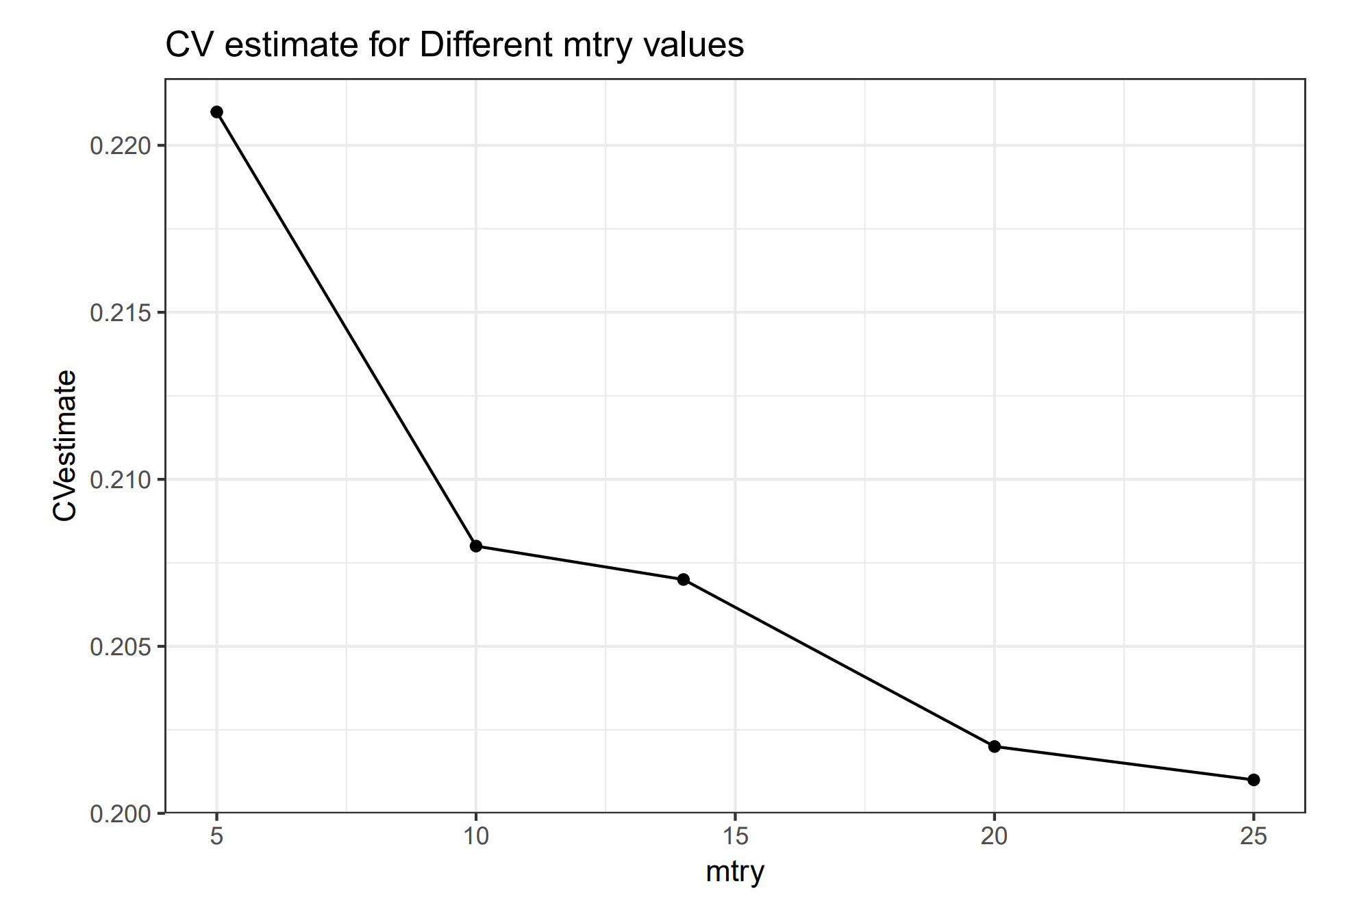

Slide 29
Bagging
Ensemble modeling method very similar to random forest
Follows identical process of creating a forest of trees
Key difference is that all variables are used in tree creation instead of a random subset
Using this method we obtained an overall predictive accuracy of 77.55% on the validation data.

Slide 30
Support Vector Machine
SVMs are extensions of the support vector classifier which works by finding a decision boundary that has maximum margins from the data point from either of the classes that are closest to a separating plane
The cost parameters controls the width of the decision boundary
Different costs including 0.01, 0.05, 0.1, 0.5, 1 were used with 5-fold CV, resulting in a chosen cost of 0.05 with 21.24% accuracy
An SVM with this cost gave a validation accuracy of 79.62%

Slide 31
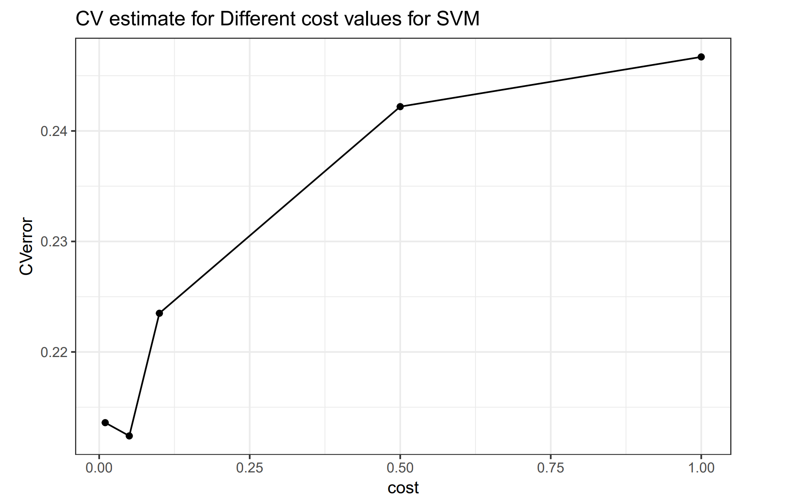

Slide 32
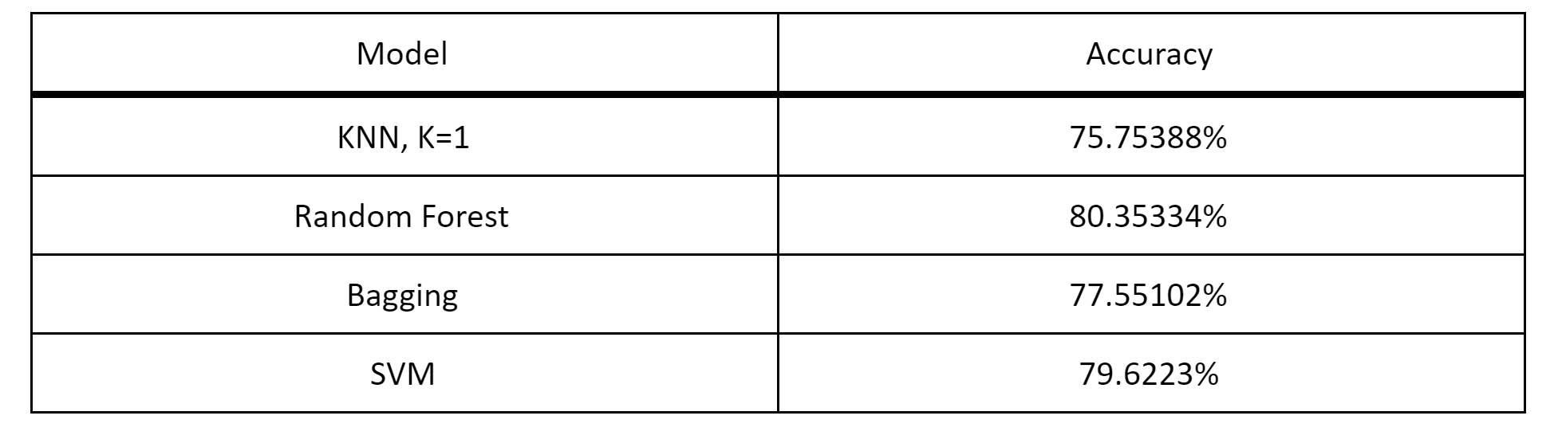
Model Selection

Slide 33
Model Selection
Looked at by-character predictive accuracy to determine final model selection between random forest and SVM
While there was some variance between the two, it was largely negligible
The noticeable difference that resulted in the selection of random forest was that SVM was unable to successfully label any 0’s
In terms of overall performance, random forest performs best on letters and worst on numbers that look like similar to letters (such as 1 vs I, 2 vs Z, and 5 vs S)

Slide 34
Conclusion and Future Analysis
Alternative variable selection methods
PCA - Not chosen because of computational expense
Could potentially eliminate remaining “border” variables post-reduction
Ambiguous characters
Similar characters such as those mentioned in the previous slide pose an ongoing challenge for this data

Slide 35
Thank you!

Slide 36
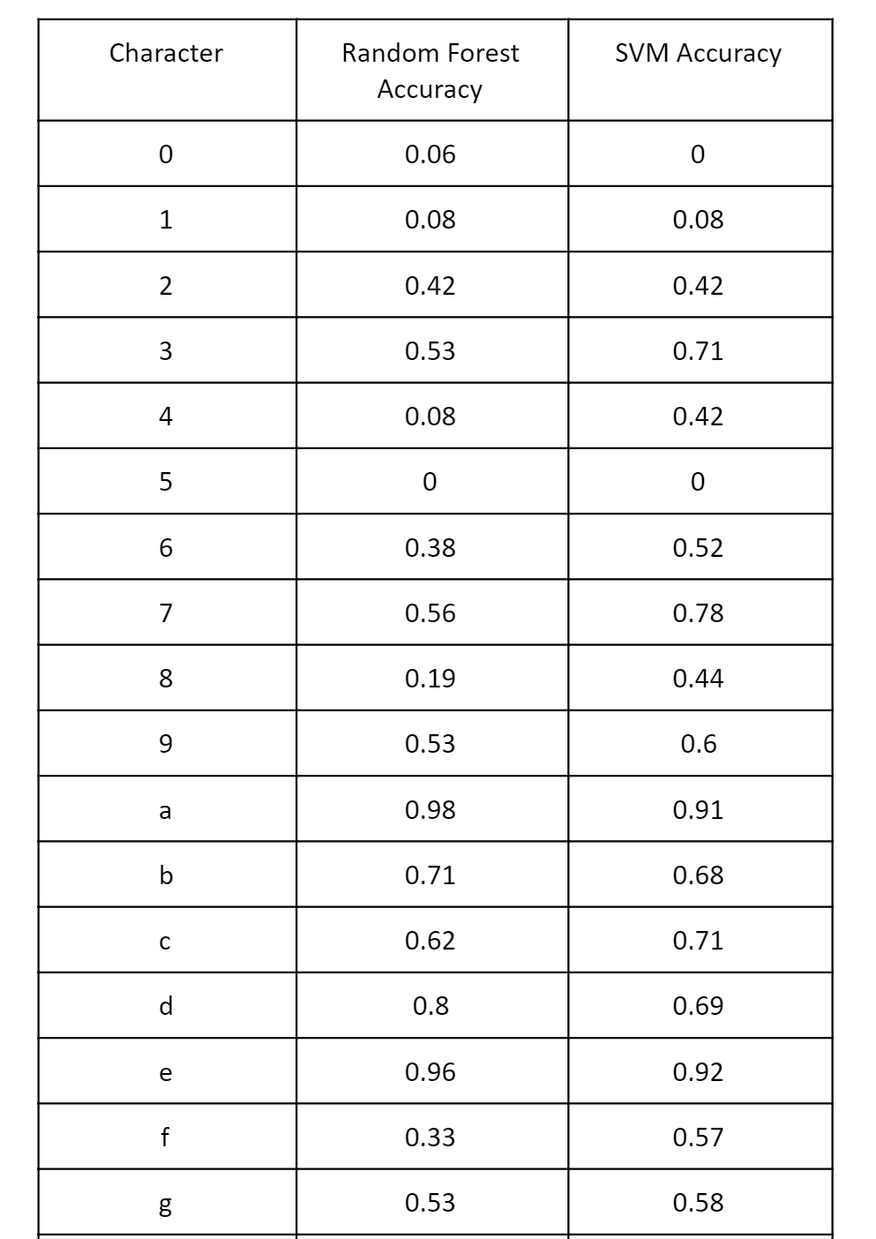
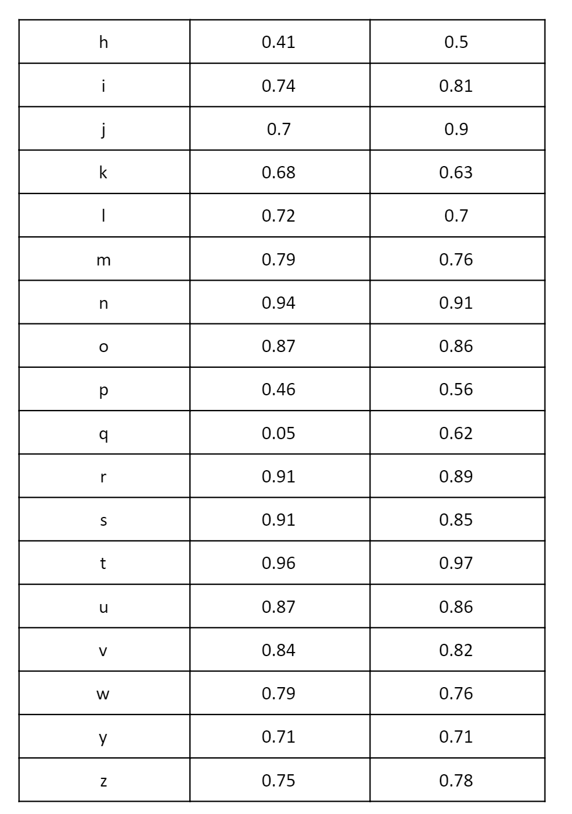

Slide 37
Reduced Confusion Matrices for Ambiguous Characters

Slide 38
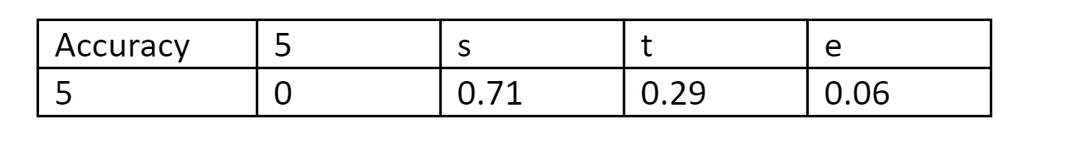
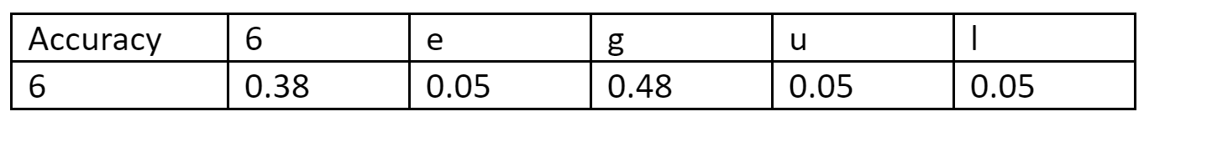

Slide 39
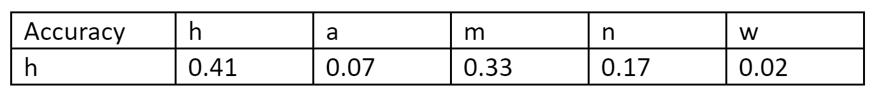
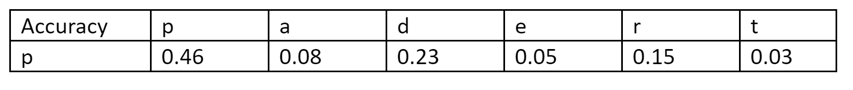
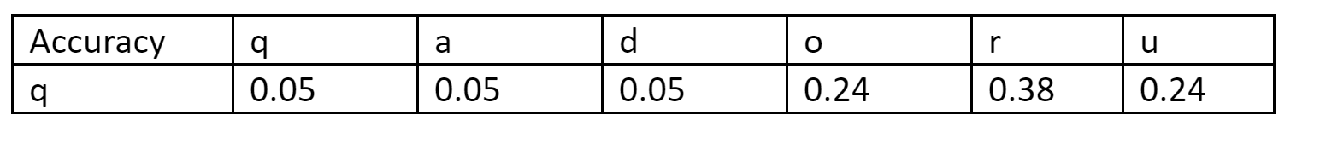

Slide 40
